Slide 1
rubrik
Brödtext
Notes:
S

Slide 2
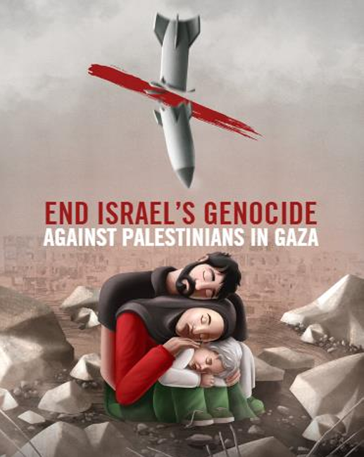
Introduction
“ Today, we will explore Amnesty International’s detailed report titled ‘YOU FEEL LIKE YOU ARE SUBHUMAN: Israel's Genocide Against Palestinians in Gaza.’ This report, published in 2024, examines evidence of alleged genocide and systemic human rights violations in Gaza following the October 2023 offensive”
Notes:
Welcome everyone. Today, we will delve into Amnesty International’s report titled "You Feel Like You Are Subhuman: Israel's Genocide Against Palestinians in Gaza", published in 2024. This report investigates alleged genocide and systemic human rights violations in Gaza following the October 2023 offensive.

Slide 3
Introduction oVerview
Amnesty’s Methodology & Evidence
A Brief Overview of Genocide Under International Law
Our Application of the Genocide Convention as a Legal Framework
Amnesty’s Legal Conclusion on Israel’s Genocide Against Palestinians
What the Three Prohibited Acts and Israel’s Genocidal Intent Mean in Practice
Amnesty’s Demands
Notes:
Before we begin, we want to present the structure of today’s presentation. We will cover the following topics:
Amnesty’s methodology and evidence.
A brief overview of genocide under international law.
Our application of the Genocide Convention as a legal framework.
Amnesty’s legal conclusion on Israel’s genocide against Palestinians.
What the three prohibited acts and Israel’s genocidal intent mean in practice.
Amnesty’s demands.

Slide 4
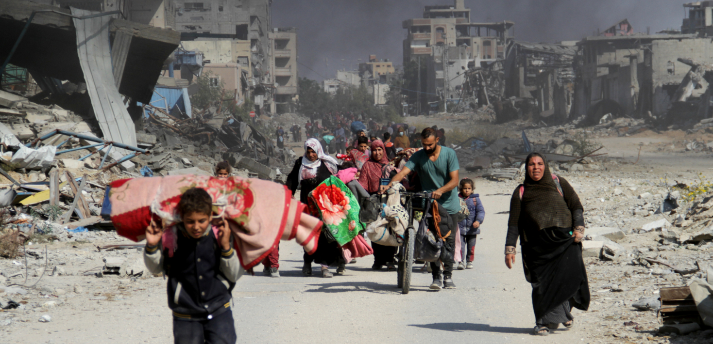
Background and Context
Gaza is one of the most densely populated regions in the world. Its population faces daily challenges due to years of occupation, systemic restrictions, and limited resources. The October 2023 military offensive significantly worsened these conditions
Notes:
Gaza is one of the world’s most densely populated regions, with over 2.2 million people living in just 365 square kilometers. Years of occupation, systemic restrictions, and limited resources have created daily challenges for its population. The October 2023 military offensive greatly exacerbated these struggles.

Slide 5
Background and Context
Gaza has been under blockade since 2007, severely restricting movement and trade.
Prior to the offensive, 80% of the population relied on humanitarian aid.
The region’s infrastructure was already struggling under repeated military offensives.
Notes:
Since 2007, Gaza has been under blockade, severely restricting movement and trade. By 2023, 80% of its population relied on humanitarian aid. Even before the offensive, Gaza’s infrastructure was in crisis due to repeated military actions

Slide 6
Background and Context
Over 2.2 million people live in an area of just 365 square kilometers.
The population includes a high proportion of children, making the impact of violence even more devastating.
International warnings about Gaza’s humanitarian situation were largely ignored.
The 2023 offensive marked a significant escalation in violence and displacement.
Notes:
The population includes a high percentage of children, making the impact of violence particularly devastating. Despite international warnings about Gaza’s worsening humanitarian situation, the 2023 offensive marked an alarming escalation in violence and displacement.

Slide 7
Method and Evidence
The majority of investigations October 7, 2023 – July 2024, with verification and updates thereafter.
Based on Amnesty's investigations published in separate statements since October 7, 2023.
Visual and digital evidence, including satellite images, videos, photos, media reports, statements, reports, and data from UN agencies, humanitarian organizations, as well as Palestinian and Israeli human rights groups.
Notes:
Methodology and Evidence
The majority of investigations were conducted between October 7, 2023, and July 2024, with verification and updates continuing thereafter. Amnesty’s findings are based on investigations published in separate statements since October 7, 2023. Evidence includes visual and digital materials such as satellite imagery, videos, photos, media reports, statements, reports, and data from UN agencies, humanitarian organizations, and both Palestinian and Israeli human rights groups.
Over nine months, we examined various incidents and documented Israel’s actions. Additionally, we analyzed developments after July 2024 to verify and confirm information. Updates on deaths, injuries, and displacements were made up until September-October 2024, reflecting a year-long timeline. We also incorporated international assessments, including updates from UN bodies and developments in court cases within Israel and on an international level.
From October 2023 to September 2024, Amnesty interviewed 212 individuals, many multiple times, to document Israel’s systematic actions in Gaza. These interviews included victims and witnesses of airstrikes, displacement, detention, destruction of civilian infrastructure, and restrictions on humanitarian aid. To understand the specific issues related to humanitarian aid and living conditions, Amnesty spoke with local authorities in Gaza, Palestinian healthcare workers, humanitarian organizations, and Israeli and Palestinian NGOs.
Our analysis includes visual and digital evidence documenting the actions of Israeli forces in Gaza. We examined satellite images, videos, and photos published online or directly obtained by investigators. We also reviewed a vast number of media reports, statements, and reports from international organizations, the UN, and human rights groups from both sides.

Slide 8
Continued Methodology and Evidence
Statements from senior officials within the Israeli government and military.
Legal submissions to Israeli courts.
Material related to South Africa’s genocide case against Israel in the International Court of Justice (ICJ).
Attempts to Engage with Israeli Authorities:
Amnesty attempted to contact Israeli authorities five times (two in late 2023 and three in 2024) to present findings. Despite follow-ups, no substantive response was received.
This lack of engagement underscores Israel’s unwillingness to address these accusations transparently.
Notes:
Continued Methodology and Evidence
Our conclusions are further supported by statements from senior Israeli government and military officials directly responsible for the military offensive in Gaza. We also analyzed submissions to and decisions by Israeli courts, along with publicly available material related to South Africa’s genocide case against Israel in the International Court of Justice (ICJ). Despite multiple attempts to engage with Israeli authorities on our findings, we received no substantive response.
Amnesty has sought constructive dialogue with Israeli authorities regarding our investigations and findings throughout the armed conflict. Specific to the evidence underpinning our conclusions, Amnesty attempted to contact the Israeli authorities five times, including twice in late 2023 and three times in 2024. We presented summaries of our conclusions to the Israeli Ministry of Defense and followed up via email and phone. However, as of the publication of this report, no substantive response has been received from Israeli authorities. This information is critical, as questions often arise regarding how we engage with Israeli authorities.

Slide 9
Genocide Under International Law
Genocide is a crime under international law (Genocide Convention and Rome Statute).
Article II of the Genocide Convention defines five acts that constitute the crime of genocide. Each must be committed “with the intent to destroy, in whole or in part, a national, ethnic, racial, or religious group as such.”
Palestinians are considered a protected group under the Genocide Convention
Notes:
Genocide Under International Law
Genocide is a crime under international law, prohibited by both the Genocide Convention and the Rome Statute, regardless of whether it occurs during peacetime or armed conflict. Article 2 of the Genocide Convention defines five specific acts as constituting genocide, provided they are committed with the intent to destroy, in whole or in part, a national, ethnic, racial, or religious group.
The five acts are as follows:
Killing members of a group.
Causing serious bodily or mental harm to members of a group.
Deliberately inflicting conditions of life calculated to bring about a group’s physical destruction.
Imposing measures intended to prevent births within the group.
Forcibly transferring children from one group to another.
Palestinians in Gaza constitute a protected group under the Genocide Convention. This is based on their identification as a distinct national, ethnic, and racial group with shared political, social, and cultural ties, as well as a common language and traditions. The International Court of Justice (ICJ) also affirmed this determination in early 2024 as part of its provisional measures against Israel.

Slide 10
five acts that constitute the crime of genocide
Killing
Causing serious bodily or mental harm
Deliberately inflicting conditions of life intended to bring about the group’s physical destruction
Preventing births
Forcibly transferring children to another group
Notes:
Introduction
"Good day, and welcome. Today, we will explore Amnesty International’s detailed report titled ‘YOU FEEL LIKE YOU ARE SUBHUMAN: Israel's Genocide Against Palestinians in Gaza.’ This report, published in 2024, examines evidence of alleged genocide and systemic human rights violations in Gaza following the October 2023 offensive.
Key Points:
The report highlights both the immediate and long-term humanitarian crises in Gaza.
Over nine months, Amnesty International documented patterns of violations.
Evidence is drawn from satellite imagery, witness testimonies, and data from international organizations.
The findings focus on civilian harm, displacement, and infrastructural collapse.
The report calls for accountability under international law.
It aims to inform the global community and push for immediate action.
This presentation summarizes the main findings and calls to action."

Slide 11
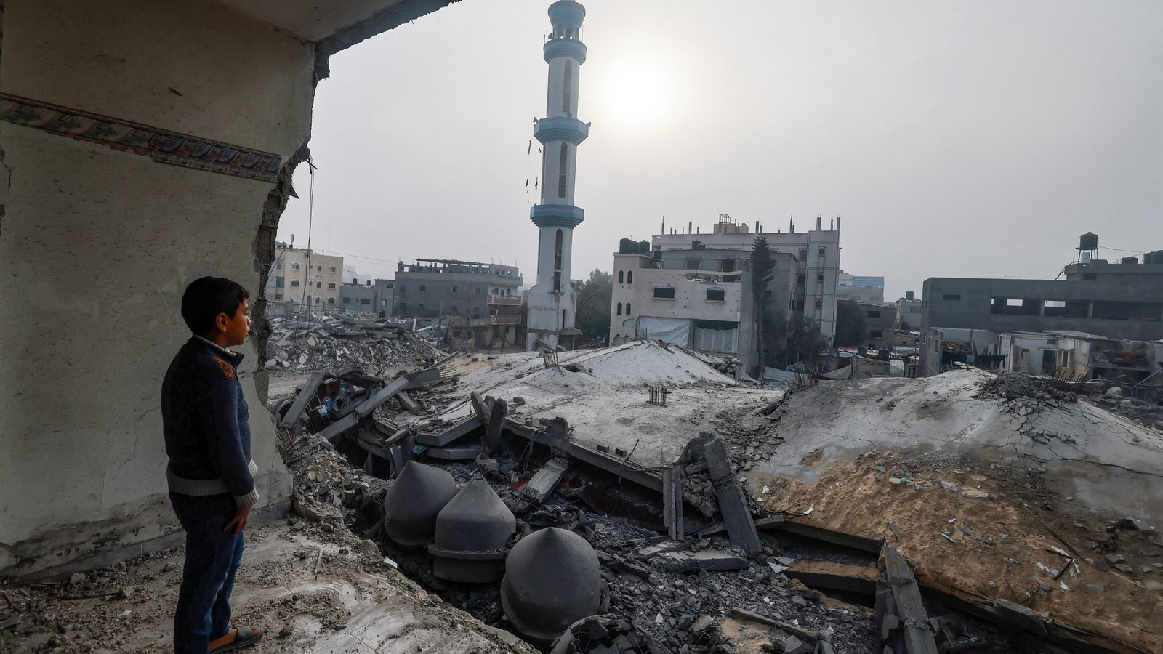
Legal Framework: Genocide
"Genocide, as defined under the 1948 Convention, involves specific acts committed with intent to destroy a group. The report applies this framework to the evidence collected”
Notes:
Legal Framework: Genocide
"Genocide, as defined under the 1948 Convention, involves specific acts committed with intent to destroy a group. The report applies this framework to the evidence collected.
Key Points:
Genocide involves both physical destruction and harm to a group’s way of life.
Specific acts include killing, causing harm, and creating conditions leading to destruction.
The intent to destroy distinguishes genocide from other crimes.
International law prohibits genocide in both peace and conflict.
Evidence must show a systematic pattern of conduct aimed at destruction.
The findings draw on international jurisprudence to establish genocidal intent.
The destruction of cultural and religious sites also provides evidence of intent."

Slide 12
Genocide Under International Law (Continued)
Establishing Genocidal Intent:
Genocidal intent does not require complete destruction but rather the intent to destroy a substantial part of the group.
For Palestinians in Gaza, this group represents 40% of the total Palestinian population in occupied territories, a substantial demographic.
Genocide can coexist with military goals, but intent to destroy a group remains distinct and prohibited under international law.
Notes:
Genocide Under International Law (Continued)
To establish genocidal intent, international jurisprudence does not require the complete destruction of a group. Instead, it must be shown that the perpetrator intended to destroy a substantial part of the group significant enough to impact the group as a whole.
Palestinians in Gaza represented approximately 40% of the 5.5 million Palestinians in the occupied territories in 2023, making them a substantial demographic. Genocidal intent can coexist with military objectives. This means that a state’s actions can serve both military goals and genocidal purposes simultaneously. International law is clear that genocide, war crimes, and crimes against humanity remain prohibited even during armed conflict and cannot be justified by military necessity.

Slide 13
Government Statements on genocide
1. President Isaac Herzog (12 October 2023):
- "It’s an entire nation out there that is responsible. It’s not true this rhetoric about civilians not aware, not involved."
2. Minister of National Security Itamar Ben-Gvir (11 November 2023):
- "To be clear, when they say that Hamas needs to be eliminated, it also means those who sing, those who support and those who distribute sweets, all of these are terrorists. And they should be eliminated!"
3. Minister of Finance Bezalel Smotrich (29 April 2024):
- "Rafah, Deir al-Balah, Nuseirat, destruction! Blot out the memory of [the people of] Amalek from under heaven."
These statements demonstrate dehumanizing language and genocidal intent.
Notes:
The report highlights a pattern of dehumanizing rhetoric and genocidal intent through statements by senior Israeli officials:

Slide 14
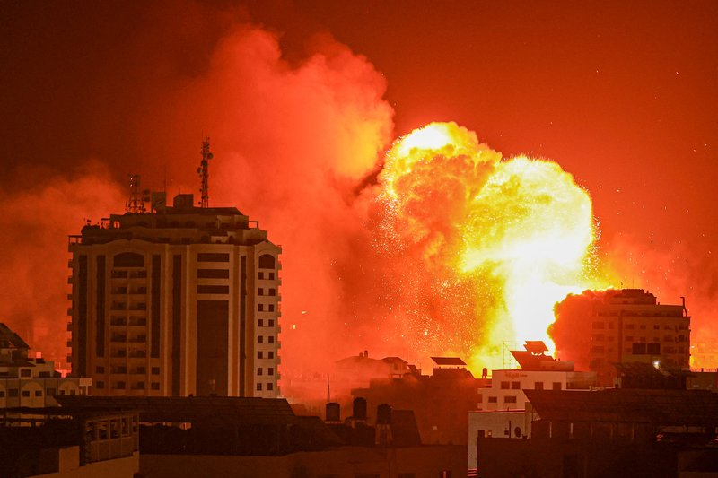
Specific Intent to Destroy
"The report highlights evidence pointing to genocidal intent in Israel’s actions during the offensive”
Notes:
The report highlights evidence of intent to destroy Gaza’s population:
Systematic targeting of civilians and infrastructure.
Forced displacement on a massive scale.
Obstruction of humanitarian aid, despite global condemnation. These acts collectively reveal an overarching plan to dismantle Palestinian society.

Slide 15
Specific Intent to Destroy
Repeated attacks targeted civilians and essential infrastructure.
Statements by officials dehumanized Palestinians, equating civilians with combatants.
Forced displacement and destruction were carried out systematically.
Humanitarian aid was obstructed despite international condemnation.
Notes:
Repeated attacks targeted civilians and essential infrastructure.
Statements by officials dehumanized Palestinians, equating civilians with combatants.
Forced displacement and destruction were carried out systematically.
Humanitarian aid was obstructed despite international condemnation.
Statements equating all Palestinians with combatants reveal a narrative justifying collective punishment. The scale and intensity of actions reflect an intent to dismantle Gaza’s societal structure, with children disproportionately affected.

Slide 16
Specific Intent to Destroy
The cumulative impact of these actions aimed to erase Gaza’s societal structure.
Patterns of conduct suggest a deliberate intent to destroy the group.
International law prohibits such acts, even during armed conflict.
Notes:
The cumulative impact of these actions aimed to erase Gaza’s societal structure.
Patterns of conduct suggest a deliberate intent to destroy the group.
International law prohibits such acts, even during armed conflict.
These actions collectively demonstrate deliberate intent to destroy a protected group, fulfilling the requirements of specific intent under international law. Such intent is crucial for establishing the crime of genocide.

Slide 17
Israel's Intent for Genocide
In accordance with international legal practice – “the only reasonable conclusion”
A comprehensive, repeated, and systematic pattern of actions (the prohibited acts)
Dehumanizing, racist language and calls for or justification of genocidal actions
Consideration of Israel's apartheid, illegal 57-year military occupation, and 17-year blockade of Gaza
Notes:
Israel’s Genocidal Intent
Amnesty’s analysis follows international legal precedent, which uses the “only reasonable conclusion” standard to establish genocidal intent. Despite Israel’s stated military objective to dismantle Hamas, the evidence indicates that its actions also aimed to destroy Palestinians in Gaza as a group.
This conclusion is based on repeated and systematic prohibited acts, dehumanizing rhetoric, and policies designed to create unlivable conditions. Statements by Israeli officials, including 22 explicitly promoting or justifying genocide, further reinforce this intent. The military campaign’s scale, intensity, and targeting of civilian infrastructure demonstrate a deliberate effort to eradicate Gaza’s population.

Slide 18
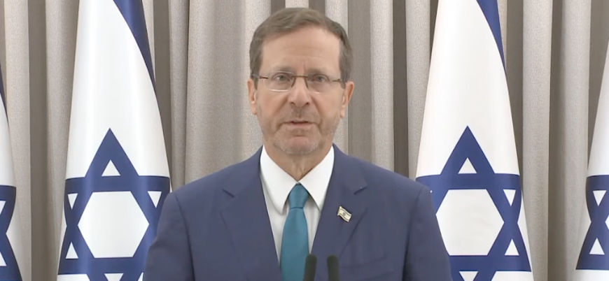
Government Statements on genocide
President Isaac Herzog
(12 October 2023):
- "It’s an entire nation out there that is responsible. It’s not true this rhetoric about civilians not aware, not involved."
Notes:
The report highlights a pattern of dehumanizing rhetoric and genocidal intent through statements by senior Israeli officials:
President Isaac Herzog
(12 October 2023):
- "It’s an entire nation out there that is responsible. It’s not true this rhetoric about civilians not aware, not involved."

Slide 19
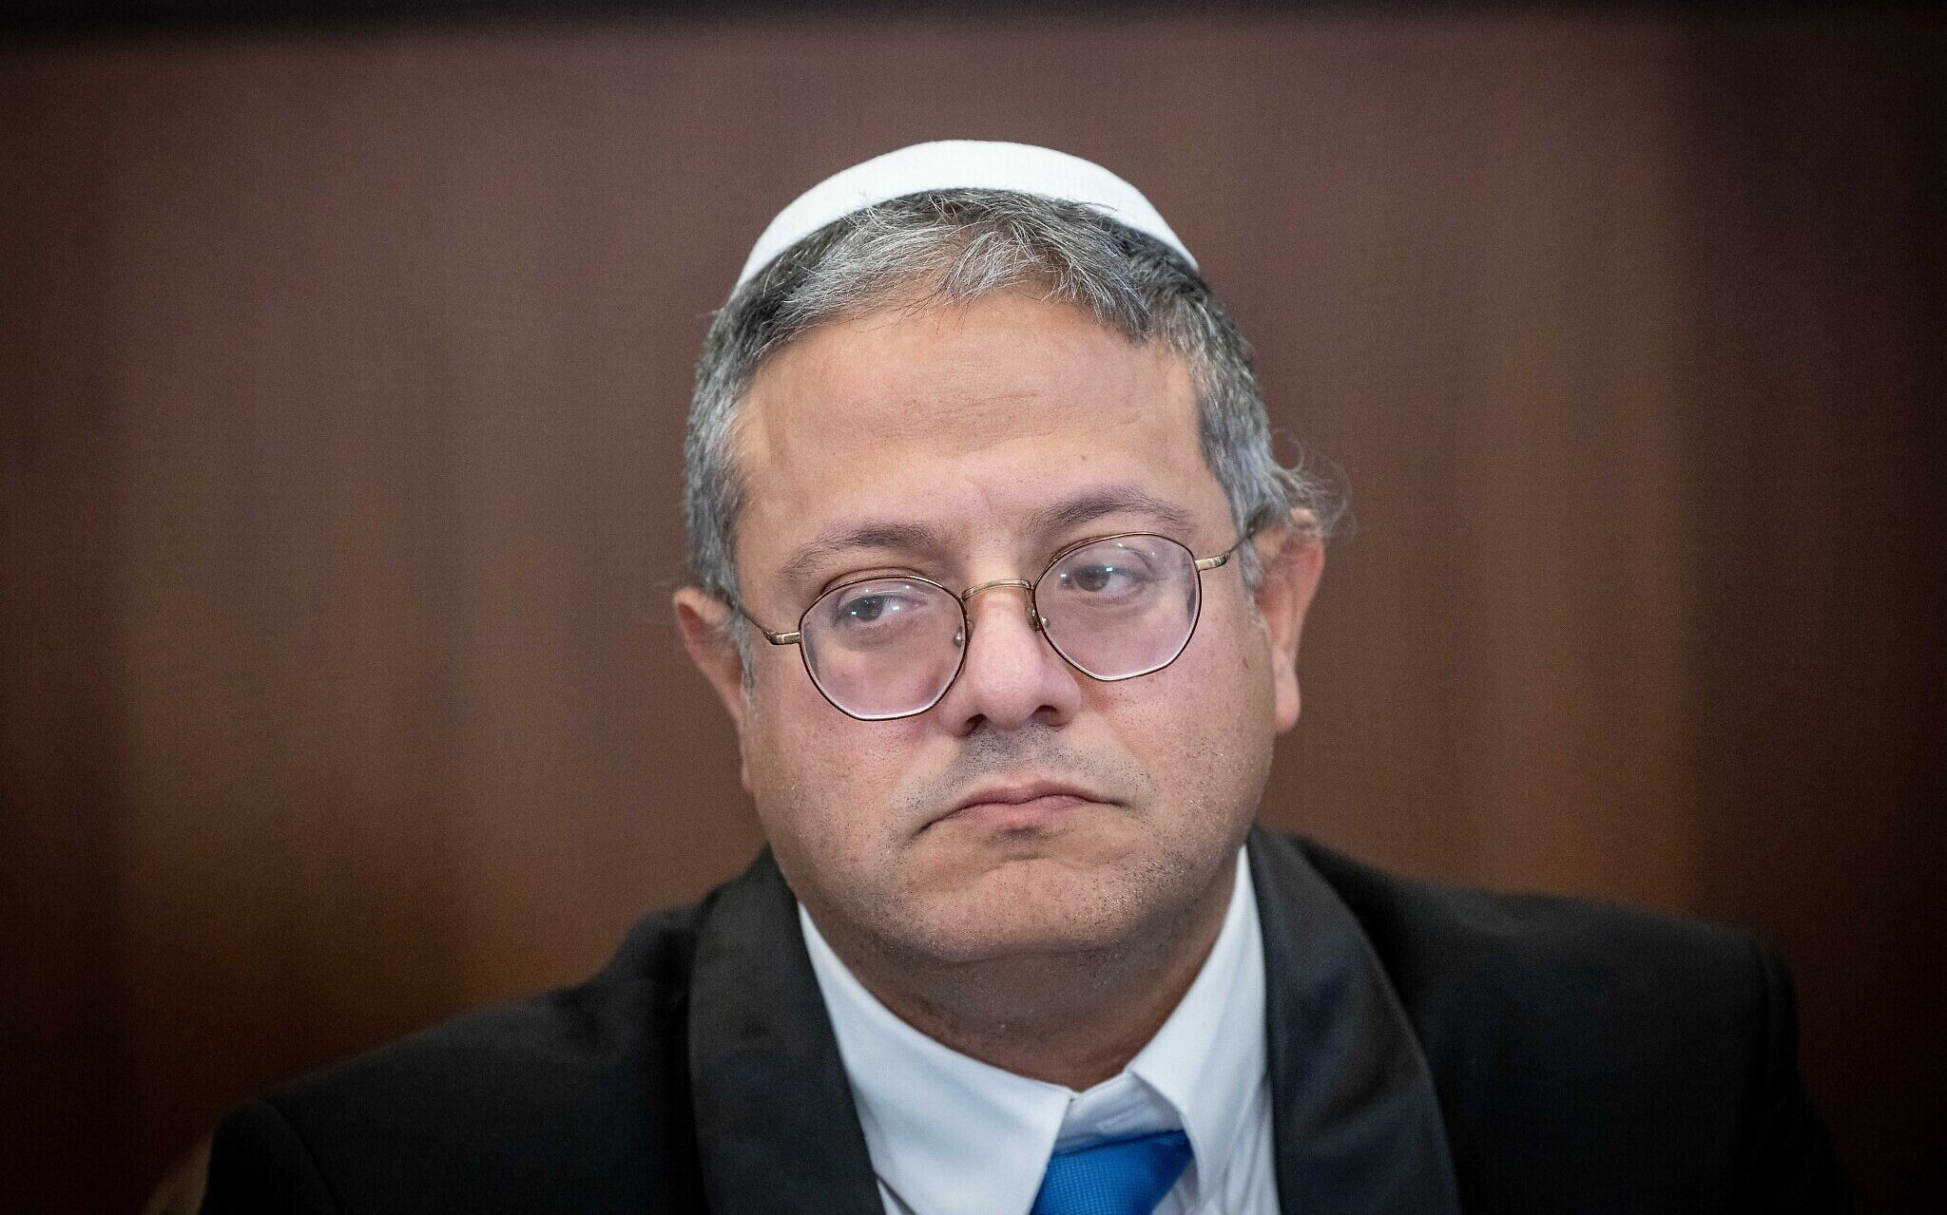
Government Statements on genocide
Minister of National Security Itamar Ben-Gvir
(11 November 2023):
- "To be clear, when they say that Hamas needs to be eliminated, it also means those who sing, those who support and those who distribute sweets, all of these are terrorists. And they should be eliminated!"
Notes:
The report highlights a pattern of dehumanizing rhetoric and genocidal intent through statements by senior Israeli officials:
Minister of National Security Itamar Ben-Gvir
(11 November 2023):
- "To be clear, when they say that Hamas needs to be eliminated, it also means those who sing, those who support and those who distribute sweets, all of these are terrorists. And they should be eliminated!"
These remarks reflect a narrative of collective blame and dehumanization.

Slide 20
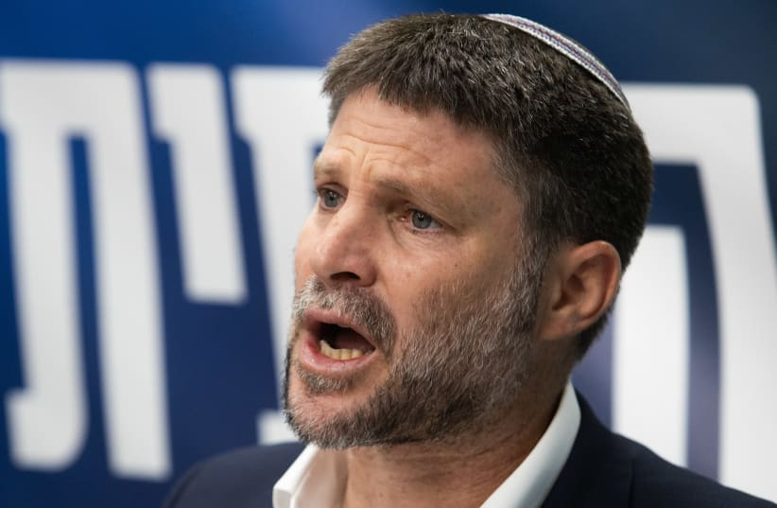
Government Statements on genocide
Minister of Finance
Bezalel Smotrich (29 April 2024):
- "Rafah, Deir al-Balah, Nuseirat, destruction! Blot out the memory of [the people of] Amalek from under heaven."
Notes:
The report highlights a pattern of dehumanizing rhetoric and genocidal intent through statements by senior Israeli officials:
Minister of Finance
Bezalel Smotrich (29 April 2024):
"Rafah, Deir al-Balah, Nuseirat, destruction! Blot out the memory of [the people of] Amalek from under heaven.“
Minister Bezalel Smotrich (April 2024) invoked a Biblical narrative to justify the destruction of Palestinian areas, stating: “Blot out the memory of Amalek from under heaven.” Such rhetoric underscores genocidal intent by framing actions as morally justified.

Slide 21
Background on Government Statements
1. Generalized Blame on Civilians:
- President Isaac Herzog stated, "It’s an entire nation out there that is responsible."
2. Calls for Total Eradication:
- Minister Itamar Ben-Gvir declared that even civilians expressing solidarity with Hamas "should be eliminated."
3. Religious Justifications for Destruction:
- Minister Bezalel Smotrich referenced the Biblical story of Amalek to justify the destruction of Palestinian areas.
These statements, paired with documented actions, align with patterns of conduct indicative of genocidal intent.
Notes:
1. Generalized Blame on Civilians:
- President Isaac Herzog stated, "It’s an entire nation out there that is responsible."
2. Calls for Total Eradication:
- Minister Itamar Ben-Gvir declared that even civilians expressing solidarity with Hamas "should be eliminated."
3. Religious Justifications for Destruction:
- Minister Bezalel Smotrich referenced the Biblical story of Amalek to justify the destruction of Palestinian areas.
These statements, paired with documented actions, align with patterns of conduct indicative of genocidal intent.
These statements reflect dehumanizing rhetoric that aligns with genocidal intent. When paired with systematic violence, they demonstrate a calculated strategy to eradicate a group’s existence and identity.

Slide 22
Amnesty’s Legal Conclusion
Israel commits three prohibited acts under the Genocide Convention:
Killing Palestinians in Gaza,
Causing serious bodily or mental harm,
Deliberately inflicting conditions of life calculated to bring about the physical destruction of Palestinians in Gaza.
These acts, combined with statements from senior government and military officials, indicate that Israel has intentionally committed genocide against Palestinians in Gaza.
This occurs within the context of apartheid, illegal military occupation, and the blockade of Gaza
Notes:
Amnesty’s Legal Conclusion
Israel is committing three prohibited acts under the Genocide Convention:
Killing Palestinians in Gaza.
Causing serious bodily or mental harm.
Deliberately inflicting conditions of life calculated to lead to the group’s physical destruction.
These actions, combined with statements from senior government and military officials responsible for the offensive, demonstrate Israel’s genocidal intent. While not part of the legal conclusion, these acts occur within the context of a 57-year-long illegal military occupation, apartheid policies, and a 17-year blockade of Gaza. The blockade exacerbates the third prohibited act of deliberately inflicting life conditions calculated to bring about destruction.

Slide 23
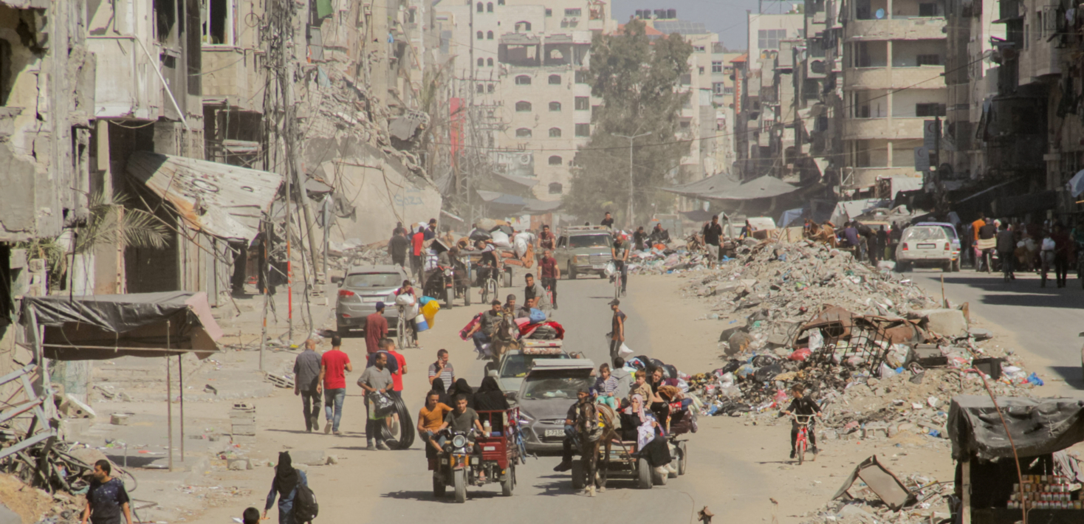
KEY FINDINGS
"The report identifies critical patterns of human rights violations and systemic harm inflicted on Gaza’s population”
Notes:
Key Findings
"The report identifies critical patterns of human rights violations and systemic harm inflicted on Gaza’s population.

Slide 24
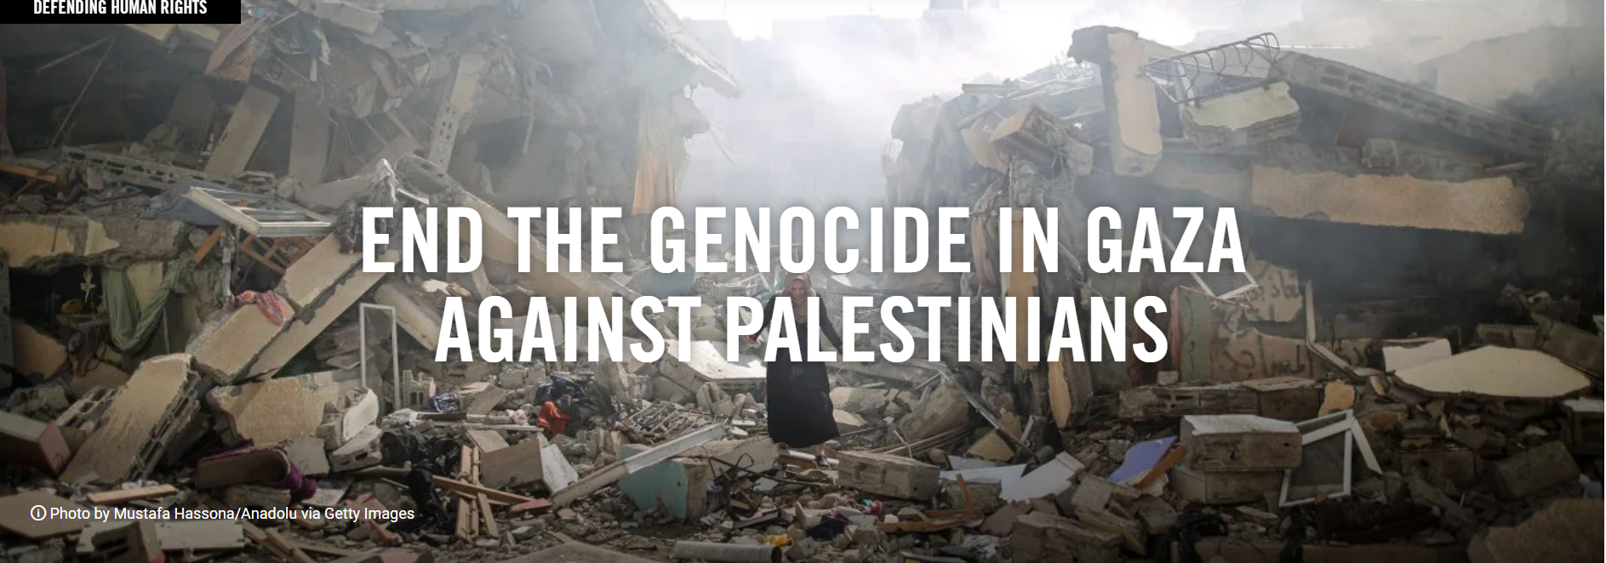
Killings and Injuries
"The toll on Gaza’s civilian population is staggering, with thousands of lives lost in targeted and indiscriminate attacks”

Slide 25
Killings and Injuries
"Over 42,000 fatalities were recorded, including 13,319 children.
Entire families were wiped out in single airstrikes.
Weapons with wide-area effects were used in densely populated areas.
Nighttime bombings targeted homes, catching civilians unaware.
Notes:
Key Points:
Over 42,000 fatalities were recorded, including 13,319 children.
Entire families were wiped out in single airstrikes.
Weapons with wide-area effects were used in densely populated areas.
Nighttime bombings targeted homes, catching civilians unaware.
Hospitals, markets, and schools were frequently hit.
Many survivors face life-changing injuries, including amputations and burns.
The psychological impact on survivors, especially children, is immeasurable."

Slide 26
Killings and Injuries
Key Findings:
15 airstrikes between October 7, 2023, and April 20, 2024, targeted civilian infrastructure, including homes, a church, a street, and a market.
Hundreds of civilians, primarily children, were killed.
Analysis:
Amnesty found no evidence of military targets in these areas.
Airstrikes were designed to maximize civilian casualties, using explosive weapons in densely populated areas without effective warnings.
Notes:
Killing and Serious Injuries
The first two prohibited acts under the Genocide Convention include killing members of a group and causing serious bodily or mental harm. These acts include the deliberate targeting of civilians through direct and indiscriminate attacks. For example, Amnesty documented 15 airstrikes carried out by Israeli forces between October 7, 2023, and April 20, 2024. These strikes hit 12 residential buildings, a church, a street, and a market, all civilian locations. Hundreds were killed, most of them children, and hundreds more were injured.
Amnesty found no evidence that these airstrikes were aimed at military targets or that those killed were combatants. The strikes were designed to maximize civilian casualties, utilizing explosive weapons in densely populated areas. The timing and location of the strikes—often conducted at night while civilians slept—exacerbated their impact. In some cases, warnings were insufficient or entirely absent, leaving civilians unprepared for the attacks.

Slide 27
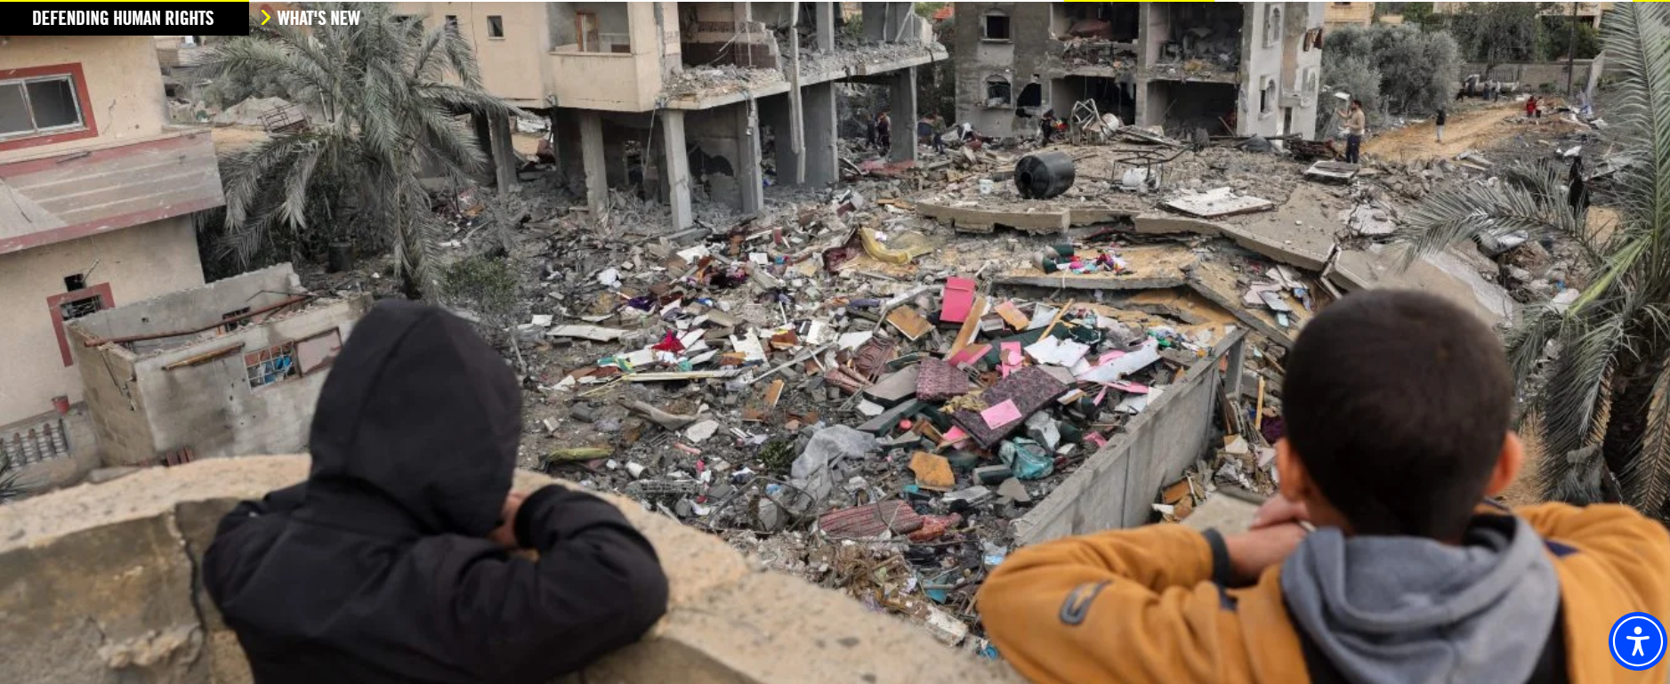
Conditions of Life in Gaza
"The living conditions in Gaza deteriorated drastically, pushing the population to the brink of survival”
Notes:
Conditions of Life in Gaza
"The living conditions in Gaza deteriorated drastically, pushing the population to the brink of survival.

Slide 28
Inflicted Living Conditions
Definition:
Methods calculated to lead to the group’s physical destruction over time.
Examples:
Destruction of civilian infrastructure (water, sanitation, healthcare).
Forced displacement: 1.9 million Palestinians forcibly displaced by July 2024, many multiple times.
Denial of basic necessities: food, water, and medical supplies severely restricted under the blockade.
Notes:
The third prohibited act involves deliberately inflicting conditions of life calculated to bring about the group’s physical destruction. Amnesty documented widespread destruction of essential infrastructure, including food production systems, water and sanitation networks, healthcare facilities, roads, and housing. By January 2024, 84% of healthcare facilities and 57% of water infrastructure in Gaza had been damaged or destroyed, according to a joint assessment by the World Bank, EU, and UN.

Slide 29
Conditions of Life in Gaza
By July 2024, 63% of Gaza’s infrastructure had been damaged or destroyed.
Critical water, sanitation, and healthcare systems collapsed.
Over 15% of children under two suffered from acute malnutrition.
Diseases like sepsis and respiratory infections surged in overcrowded shelters.
Notes:
Conditions of Life in Gaza
"The living conditions in Gaza deteriorated drastically, pushing the population to the brink of survival.
Key Points:
By July 2024, 63% of Gaza’s infrastructure had been damaged or destroyed.
Critical water, sanitation, and healthcare systems collapsed.
Over 15% of children under two suffered from acute malnutrition.
Diseases like sepsis and respiratory infections surged in overcrowded shelters.
The Israeli blockade prevented the import of essential goods, including fuel and medical supplies.
Families resorted to eating wild plants and animal fodder to survive.
The collapse of basic services led to preventable deaths, particularly among children."

Slide 30
Conditions of Life in Gaza
The Israeli blockade prevented the import of essential goods, including fuel and medical supplies.
Families resorted to eating wild plants and animal fodder to survive.
The collapse of basic services led to preventable deaths, particularly among children.
Notes:
Conditions of Life in Gaza
"The living conditions in Gaza deteriorated drastically, pushing the population to the brink of survival.
Key Points:
By July 2024, 63% of Gaza’s infrastructure had been damaged or destroyed.
Critical water, sanitation, and healthcare systems collapsed.
Over 15% of children under two suffered from acute malnutrition.
Diseases like sepsis and respiratory infections surged in overcrowded shelters.
The Israeli blockade prevented the import of essential goods, including fuel and medical supplies.
Families resorted to eating wild plants and animal fodder to survive.
The collapse of basic services led to preventable deaths, particularly among children."

Slide 31
Mass Displacement
"The forced displacement of Gaza’s population is unparalleled, with civilians enduring repeated evacuations under extreme conditions”
Notes:
Mass Displacement
"The forced displacement of Gaza’s population is unparalleled, with civilians enduring repeated evacuations under extreme conditions.

Slide 32
Mass Displacement
Over 1.9 million people, or 90% of the population, were displaced.
Many were forced to move multiple times as areas became unsafe.
Displacement zones were overcrowded, unsanitary, and lacked basic necessities.
Families were often separated, adding to the trauma.
Notes:
Additionally, forced displacement was a key component of these actions. Between October 2023 and September 2024, at least 59 evacuation orders forced 1.9 million Palestinians—90% of Gaza’s population—to flee, often multiple times. Many were displaced up to 10 times, with over a million crowding into Rafah in southern Gaza, where resources were already stretched beyond capacity.
Israel’s blockade also intensified these conditions. Restrictions on the entry of food, water, and medicine, combined with long and arbitrary inspection processes, severely limited humanitarian aid. Despite promises to increase daily truckloads of aid to 500, Amnesty’s analysis showed that the highest number permitted during the nine-month period was only 220 trucks per day.

Slide 33
Mass Displacement
Evacuation orders were confusing and left people with nowhere to go.
The displacement disrupted education, with over 625,000 students missing an entire academic year.
Conditions in displacement zones were described as “dehumanizing” by survivors.
Notes:
Mass Displacement
"The forced displacement of Gaza’s population is unparalleled, with civilians enduring repeated evacuations under extreme conditions.
Key Points:
Evacuation orders were confusing and left people with nowhere to go.
The displacement disrupted education, with over 625,000 students missing an entire academic year.
Conditions in displacement zones were described as “dehumanizing” by survivors."

Slide 34
SUMMARY KEY FINDINGS
Tens of thousands of civilians were killed or injured, many in indiscriminate attacks.
Over 90% of Gaza’s population was forcibly displaced multiple times.
Infrastructure, including schools, hospitals, and homes, was systematically destroyed.
Notes:
The findings reveal severe violations of international humanitarian law:
Tens of thousands of civilian deaths and injuries.
90% of Gaza’s population displaced multiple times. These figures underscore the catastrophic human cost of the offensive.

Slide 35
SUMMARY KEY FINDINGS
Humanitarian aid was obstructed, exacerbating suffering.
Civilians endured relentless bombing, often with no safe zones.
Children faced the highest toll, both in fatalities and in long-term trauma.
These actions constitute severe violations of international humanitarian law.
Notes:
Key Findings
Humanitarian aid was obstructed, exacerbating suffering.
Civilians endured relentless bombing, often with no safe zones.
Children faced the highest toll, both in fatalities and in long-term trauma.
These actions constitute severe violations of international humanitarian law."

Slide 36
AMNESTYS DEMANDS
"The report concludes with urgent recommendations to address the crisis and prevent further violations”
Notes:
Recommendations
"The report concludes with urgent recommendations to address the crisis and prevent further violations.
Key Points:
An immediate cessation of hostilities is essential to save lives.
Unrestricted humanitarian access must be guaranteed.
Perpetrators of violations should face accountability through international mechanisms.
Comprehensive support is needed to rebuild Gaza’s infrastructure and society.
International actors must pressure Israel to comply with humanitarian laws.
Long-term strategies should focus on addressing the root causes of the conflict.
Advocacy and solidarity are crucial in amplifying the voices of affected communities."

Slide 37
AMNESTYS DEMANDS
Israel must end its genocide against Palestinians in Gaza.
Third states have an obligation to prevent and punish genocide.
Ensure accountability, reparations for victims, and the end of impunity.
Immediate Actions:
States must halt arms transfers to Israel and support international investigations.
Pressure Israel to allow international observers and evidence collection in Gaza.
Notes:
Amnesty demands that Israel immediately cease its genocide against Palestinians in Gaza. All states, particularly those with influence over Israel, must fulfill their legal obligations under the Genocide Convention to prevent and punish genocide. This includes halting arms transfers to Israel, supporting international investigations, and pressuring Israel to allow independent observers into Gaza.
States must also ensure accountability by cooperating with international courts and mechanisms to prosecute those responsible for genocide and other violations of international law. Evidence collection is vital for future processes to deliver justice and reparations for victims.

Slide 38
AMNESTYS DEMANDS
International actors must pressure Israel to comply with humanitarian laws.
Long-term strategies should focus on addressing the root causes of the conflict.
Advocacy and solidarity are crucial in amplifying the voices of affected communities.
Notes:
International actors must pressure Israel to comply with humanitarian laws.
Long-term strategies should focus on addressing the root causes of the conflict.
Advocacy and solidarity are crucial in amplifying the voices of affected communities."

Slide 39
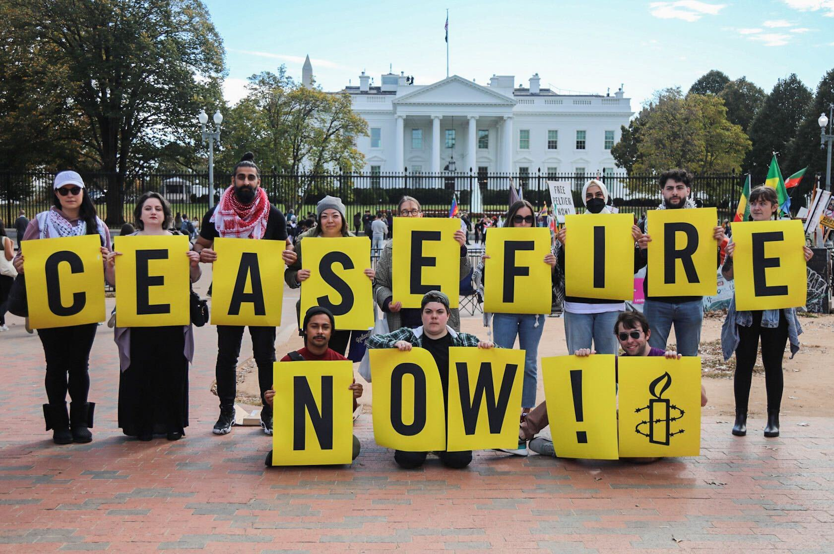
Conclusion
"In conclusion, the evidence presented in this report underscores the urgent need for action. The systematic violations in Gaza highlight the importance of accountability and the protection of human rights”
Notes:
Conclusion
"In conclusion, the evidence presented in this report underscores the urgent need for action. The systematic violations in Gaza highlight the importance of accountability and the protection of human rights.

Slide 40
Conclusion
The scale of destruction and loss is unprecedented.
Immediate intervention is necessary to prevent further atrocities.
Addressing the humanitarian crisis requires global cooperation.
Long-term peace and justice depend on addressing systemic issues.
Notes:
Key Points:
The scale of destruction and loss is unprecedented.
Immediate intervention is necessary to prevent further atrocities.
Addressing the humanitarian crisis requires global cooperation.
Long-term peace and justice depend on addressing systemic issues.
The international community must uphold its obligations under international law.
This report serves as a call to action for governments, organizations, and individuals.
Together, we can advocate for a just and sustainable resolution to the crisis."

Slide 41
Conclusion
The international community must uphold its obligations under international law.
This report serves as a call to action for governments, organizations, and individuals.
Together, we can advocate for a just and sustainable resolution to the crisis.
Notes:
Conclusion
"In conclusion, the evidence presented in this report underscores the urgent need for action. The systematic violations in Gaza highlight the importance of accountability and the protection of human rights.
Key Points:
The scale of destruction and loss is unprecedented.
Immediate intervention is necessary to prevent further atrocities.
Addressing the humanitarian crisis requires global cooperation.
Long-term peace and justice depend on addressing systemic issues.
The international community must uphold its obligations under international law.
This report serves as a call to action for governments, organizations, and individuals.
Together, we can advocate for a just and sustainable resolution to the crisis."

Slide 42
VIDEO SUMMARY
Warning! This video contains scenes some viewers may find disturbing

Slide 43
VIDEO SUMMARY
WHY IS THIS A GENOCIDE?

Slide 44
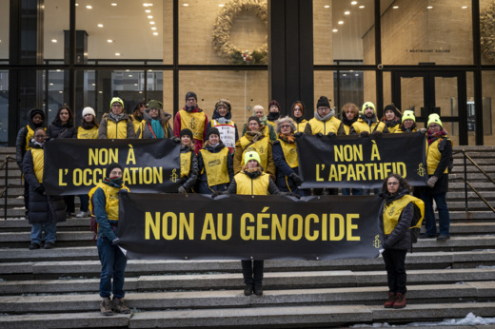
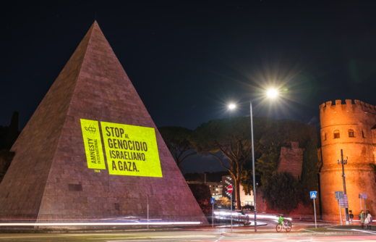
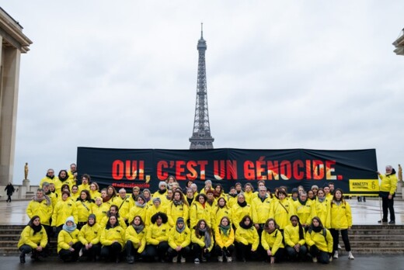
GET INVOLVED AND TAKE ACTION!
Join amnesty international

Slide 45
APPLY TO OUR MONTHLY INFOSESSIONS
Visit www.aktivism.amnesty.se

